Slide 1
Sexist Comment Detection in Chinese Social Media
Fan Yingshuang, Chen Zhihui
Fang Cunling, Guo Minxin, Sun Yize

Slide 2
Outline
Introduction
Exploratory Data Analysis
Word Embedding
Sentence Embedding
Text Classifier
Result & Discussion

Slide 3
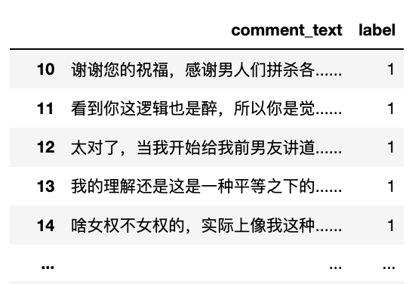
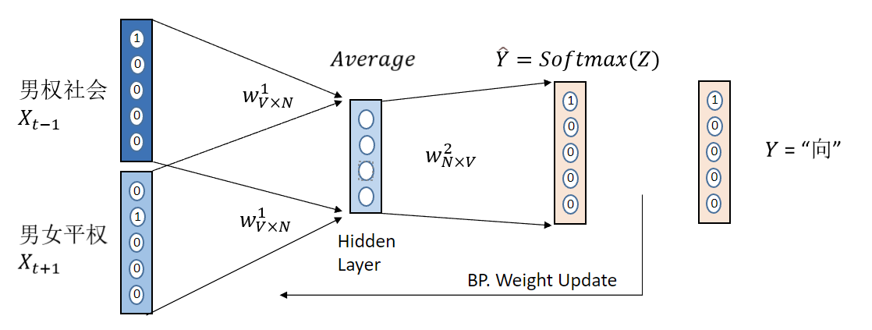
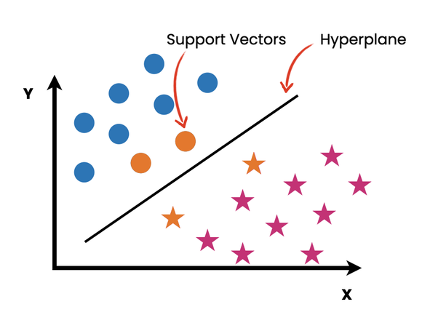
Introduction
Data Preprocessing
Model Training
Outputs
Sexist Comment Dataset
Word2Vec
SVM
Sexism or not

Slide 4
The SWSR Dataset
-Sina Weibo Sexism Review(SWSR) dataset, in the paper by Jiang et al(2022)
-Sexism related weibos and comments
-Several attributes: location and gender of the user, target, sexism identification and sexism category of the weibo/comment
-1527 weibos and 8969 comments in total

Slide 5
Hate speech detection on the SWSR dataset
Word | Translation | PCT
女权 | feminism | 29.8%
女性 | women | 25.2%
不是 | not | 19.0%
男人 | man | 11.9%
孩子 | children | 8.8%
骂 | curse | 7.5%
男权 | patriarchal | 6.1%
极端 | extreme | 5.9%
结婚 | marry | 5.3%
姓 | surname | 5.3%
-(Left) The most frequent terms in the dataset
-Hate speech detection related to sexism

Slide 6
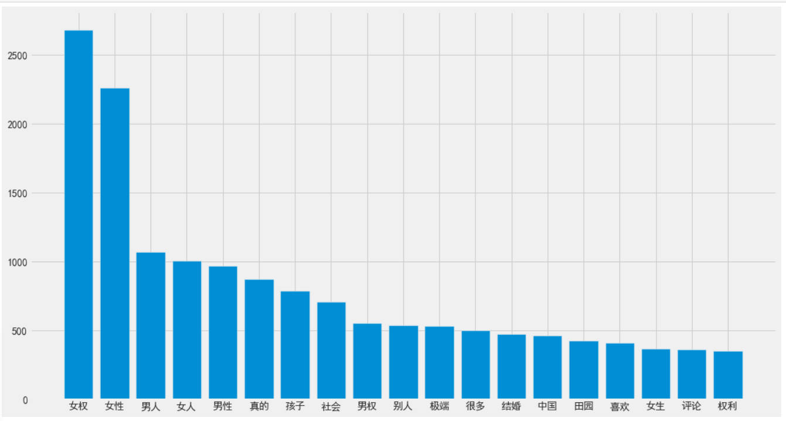
Most frequent words in comments (L=2,3,4)

Slide 7
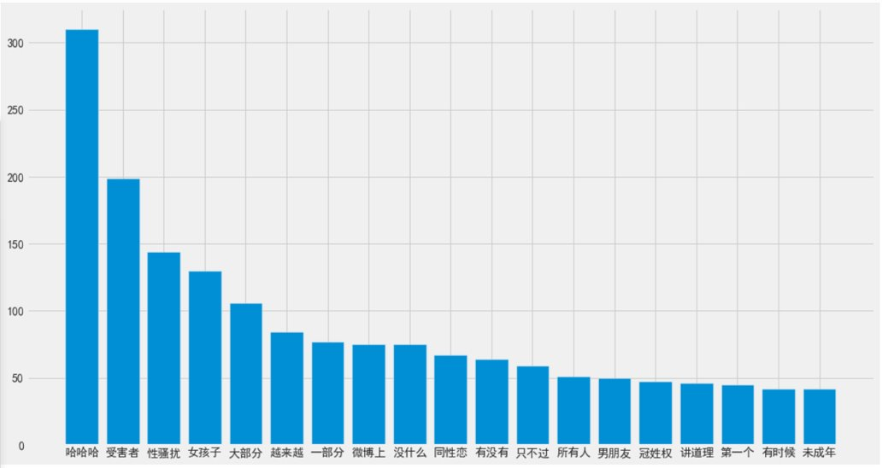
Most frequent words in comments (L=2,3,4)

Slide 8
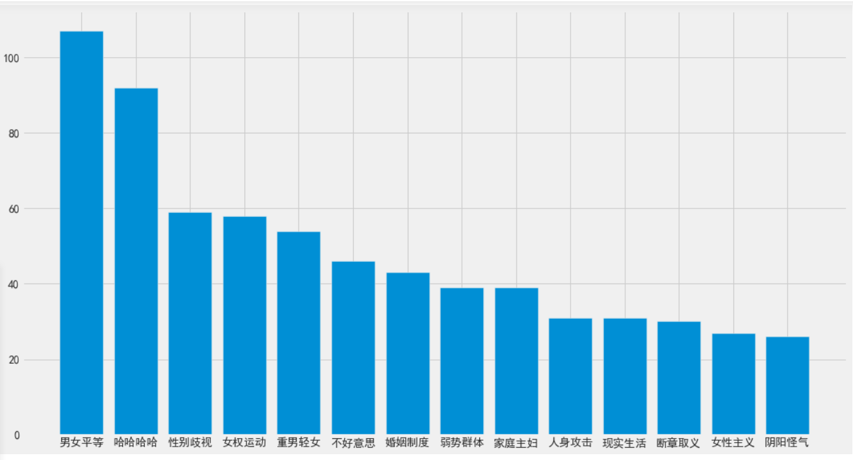
Most frequent words in comment (L=2,3,4)

Slide 9
10-Million-Sized Corpus for Sexist Comment Detection
Corpus Building Principle
A. Collect Recent Internet-based Phrases and Expressions
B. Collect Classic Writings/Theories of Chinese Sociologists on Sexual Norms& Ethics
Context Categories
A: Internet Novels Related to Sexism and Sexual Ethics
B: Books of 王小波、李银河、林奕含、张爱玲

Slide 10
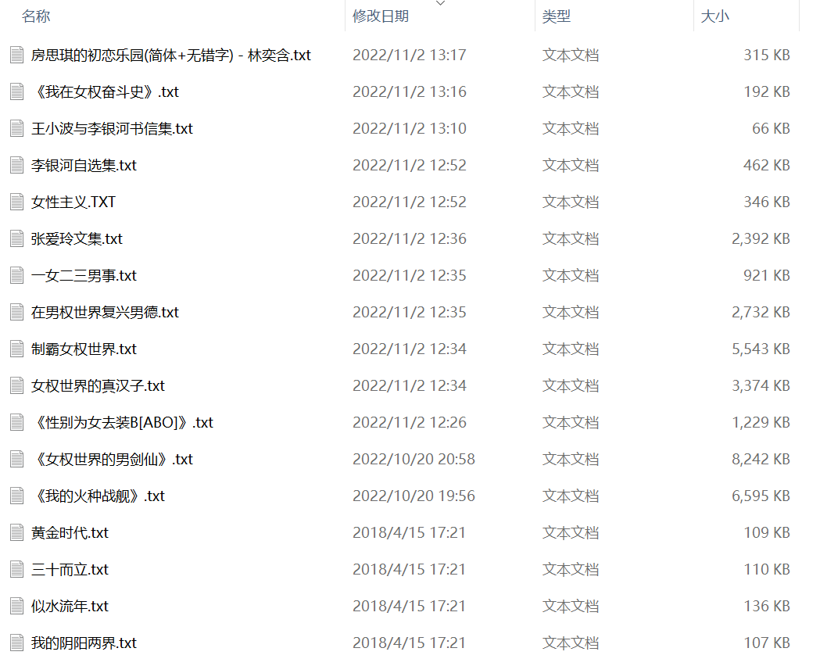
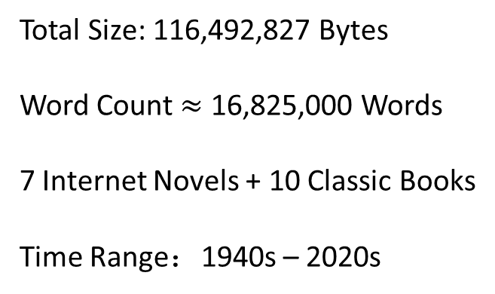
10-Million-Sized Corpus for Sexist Comment Detection

Slide 11
10-Million-Sized Corpus for Sexist Comment Detection
Internet Novels :
什么/霸道/总裁 /真娘们 /明明/就/跟/原先 /世界/中/那 一部分/完全/不讲道理/的/女人/一样
有种/职业女性/都市/小说/中/所/形容/的/冰山/美女/总裁 /的/诱惑 -- 《制霸女权世界》
Classic Books/ Novels:
女性主义/的/理论/千头万绪/归根结底/就是/一句 话/在/全人类/实现/男女平等
弗洛伊德/认为 /人类/的/性文明史/就是/人/被/压抑/的/历史 -- 李银河《女性主义》
他/说/一个/是/他/的/白玫瑰 ， 一个/是/他/的/红玫瑰 / 一个/是/圣洁/的/妻 /一个/是/热烈/的/情妇
-- 张爱玲《红玫瑰与白玫瑰》
Diverse Writing Style
Divers Expressions
Domain-Specific Words

Slide 12
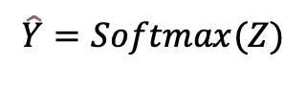
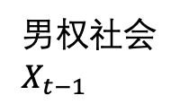
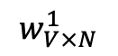
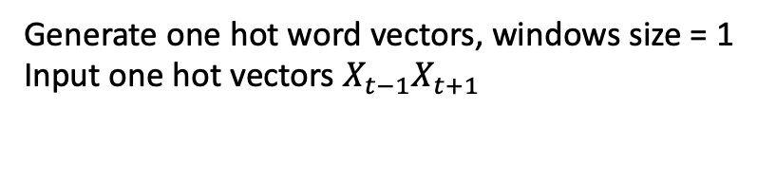
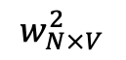
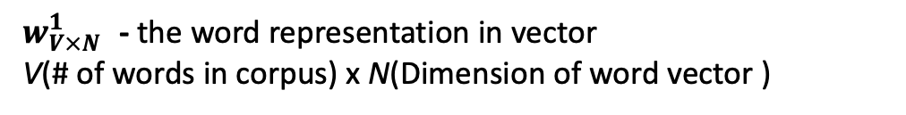
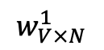
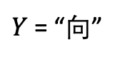
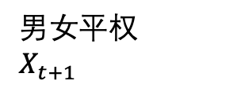
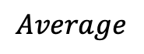
Word2Vector: Continuous Bag of Word
1
$$Average$$
$$\hat{Y}=Softmax(Z)$$
0
近现代/由/男权社会/向/男女平权/社会/转变/过程/中/逐渐/趋向 平等/的/两性关系
男权社会 $X_{t−1}$
0
$$w_{V×N}^{1}$$
0
1
0
0
0
0
$$w_{N×V}^{2}$$
1
1
$Y$ = “向”
0
0
0
0
0
1
$$w_{V×N}^{1}$$
男女平权
$$X_{t+1}$$
Hidden
Layer
0
0
BP. Weight Update
0
Generate one hot word vectors, windows size = 1
Input one hot vectors $X_{t−1}X_{t+1}$
$w_{V×N}^{1}$ - the word representation in vector
V(# of words in corpus) x N(Dimension of word vector )

Slide 13
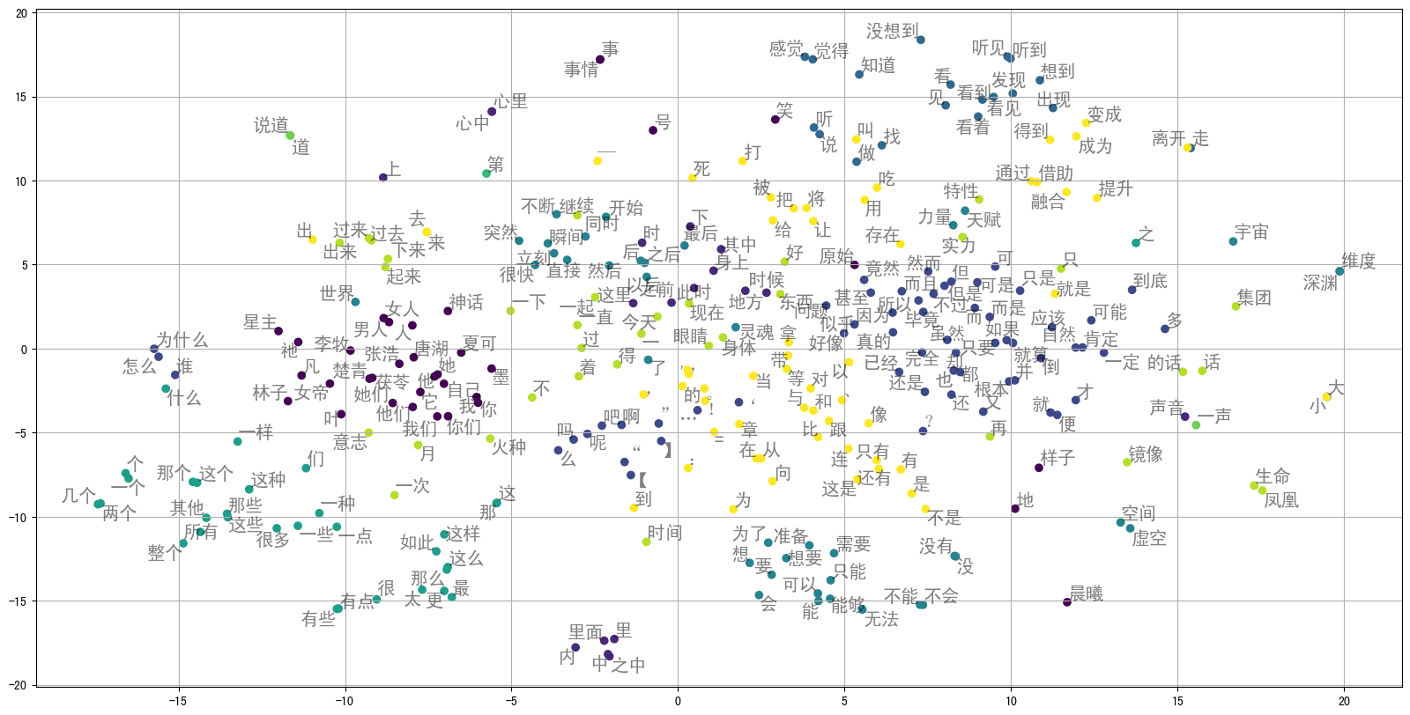
Visualization of high frequency words

Slide 14
Visualization of high frequency words

Slide 15
Visualization of high frequency words

Slide 16
Visualization of high frequency words

Slide 17
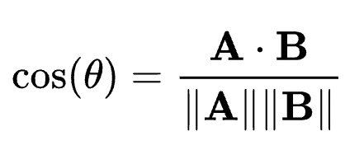
Preformance in the Sexist Comment dataset
“社会”
[ 0.80167, -0.19782, -2.1480 , …… ]
100 dim.
Cosine Similarity
“国家”
[ 0.89913 , 0.03451, 0.26539, …… ]

Slide 18
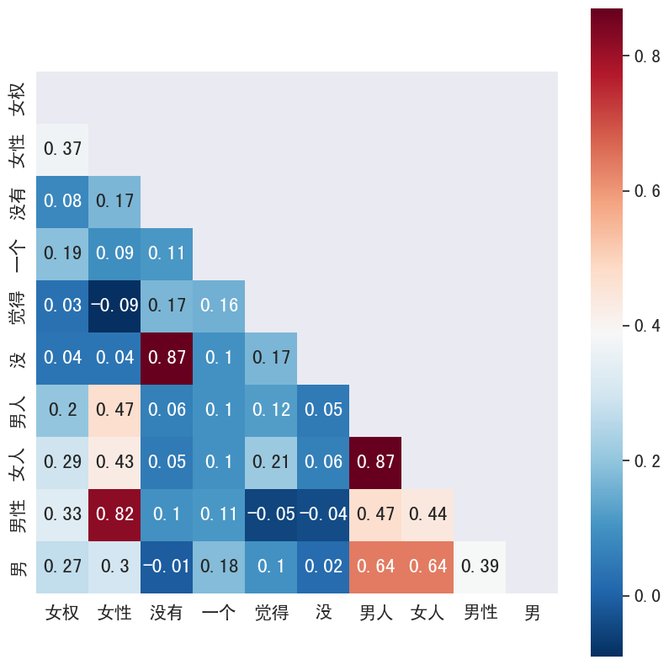








Preformance in the Sexist Comment dataset
$$\cos\left(男性，女性\right)=\text{0.82184}$$
$$\cos\left(只能，正常\right)=\text{−0.10729}$$
Cosine similarity about “歧视”：
$$\cos\left(歧视，尊重\right)=\text{0.52959}$$
$$\cos\left(歧视，男\text{性}\right)=\text{0.40543}$$
$$\cos\left(歧视，女\text{性}\right)=\text{0.37758}$$
$$\cos\left(歧视，问题\right)=\text{0.12423}$$
$$\cos\left(歧视，孩子\right)=\text{0.1075}6$$
$$\cos\left(歧视，几个\right)=\text{−0.03204}$$

Slide 19
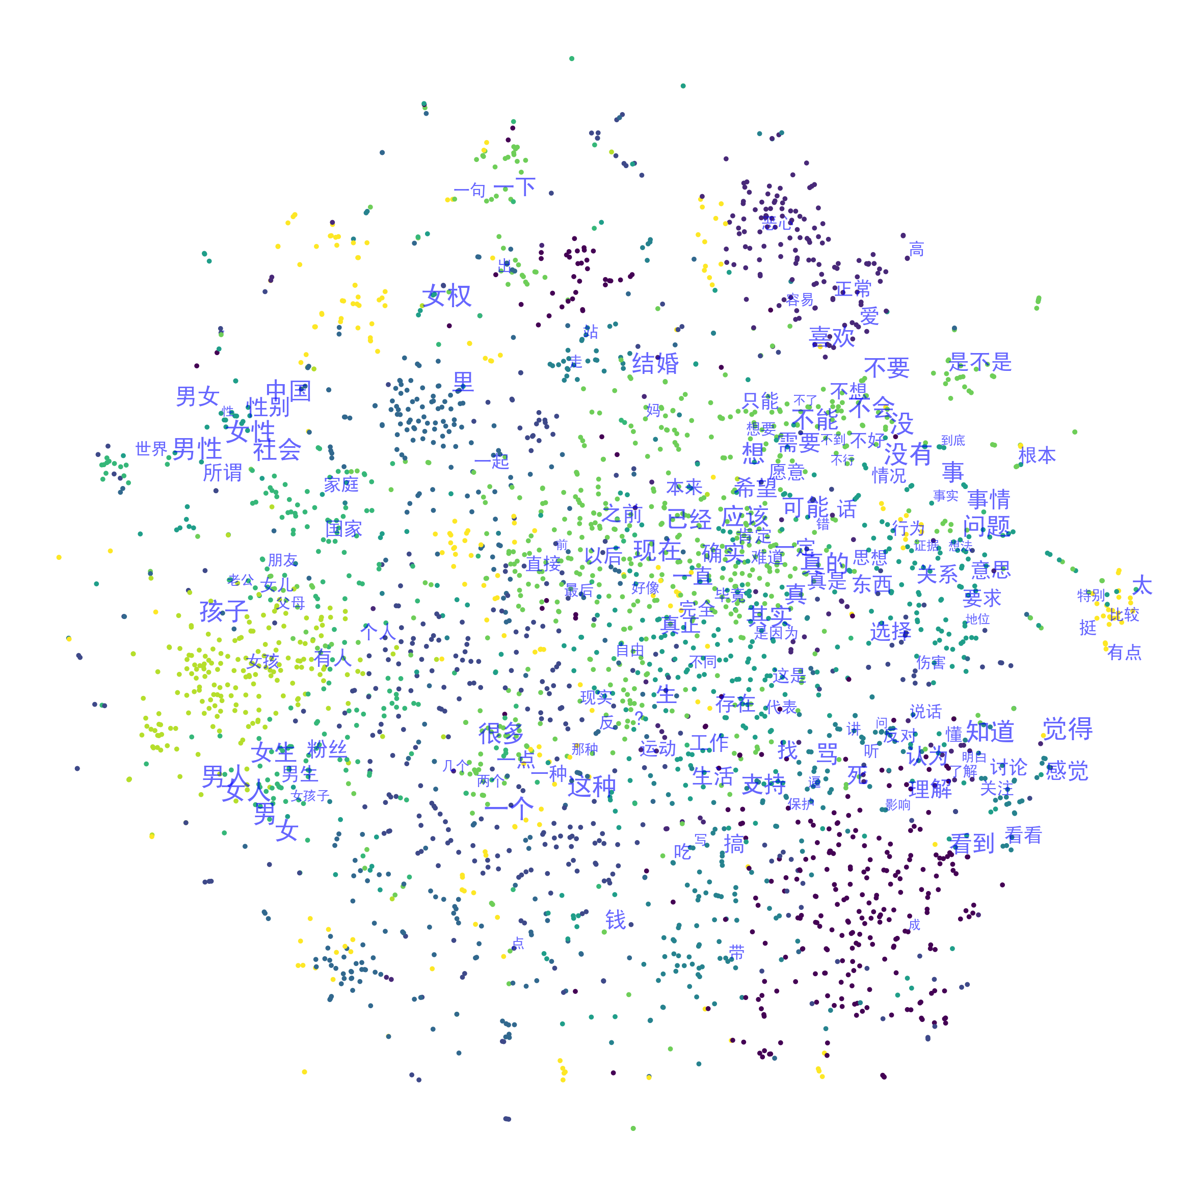
Preformance in the Sexist Comment dataset

Slide 20
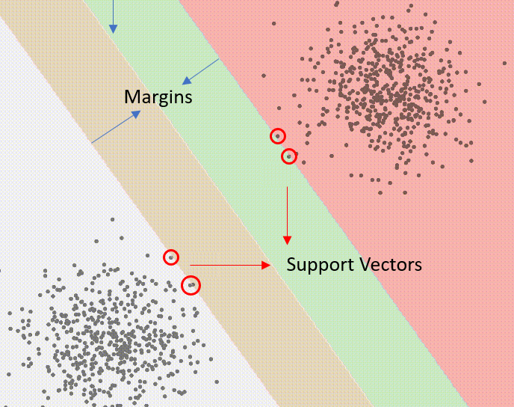
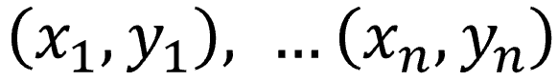
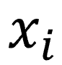
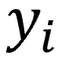
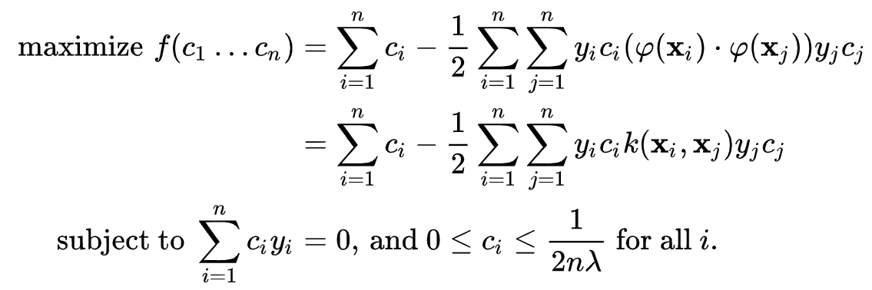
Support Vector Machine Classifier
Better interpretability on binary classification problem
Given n data pairs
X_i is a d-dimensional feature vector, y_i = 0 or 1 (class label)
we want to train a classifier which predicts the class of new input data points and thus
(1) Have a decision plane that separates data points of different class away in the domain space
(2) The plane is as far from nearest data points as possible

Slide 21
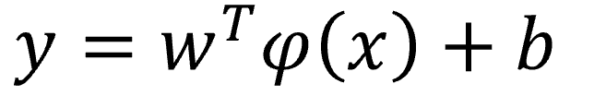
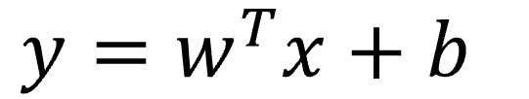
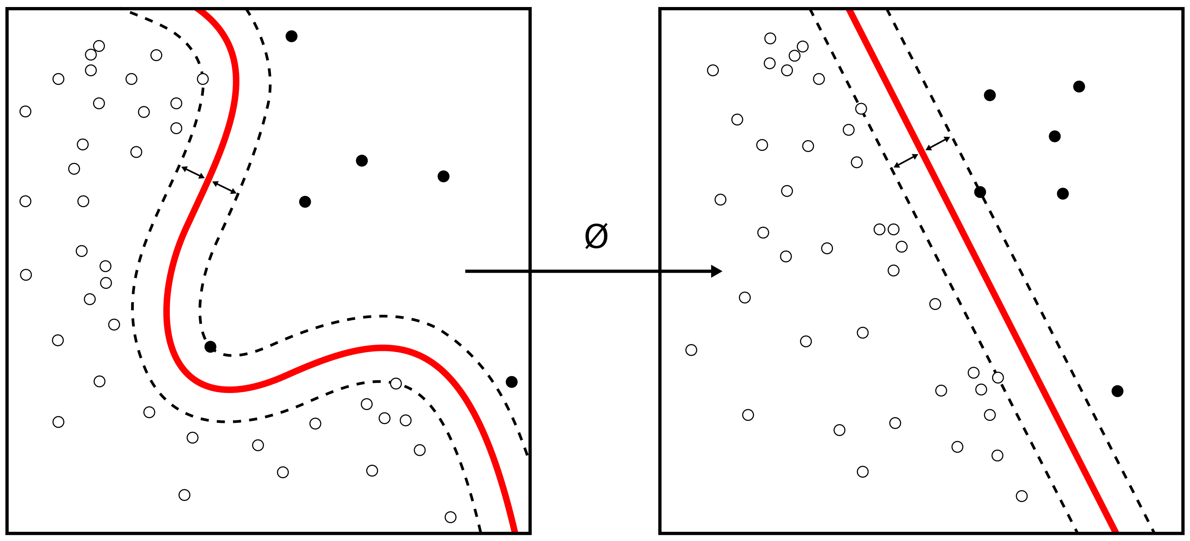
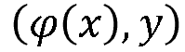
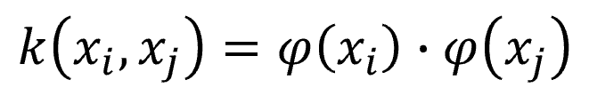
Support Vector Machine Classifier Cont.
Data is not linear separable:
Data is linear separable:
For any input feature data, we would like to find a projection φ that transforms data to a space where (φ(x), y) are linearly separable.
Kernel function:

Slide 22
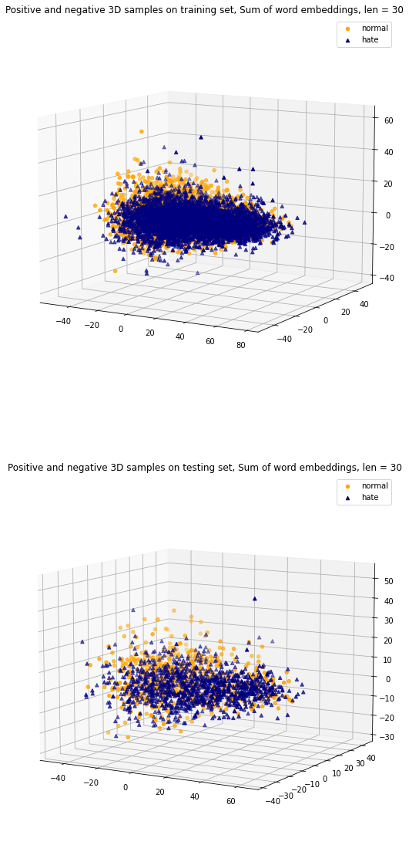
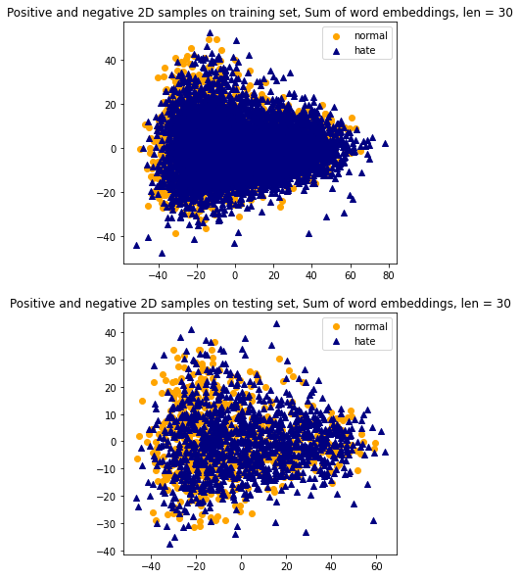
Our Sentence Data
Sum up token vectors (word embeddings) as the embedding of whole sentence
Applying PCA on sentence embeddings of training and testing set
Different class of sentences are clustering together

Slide 23
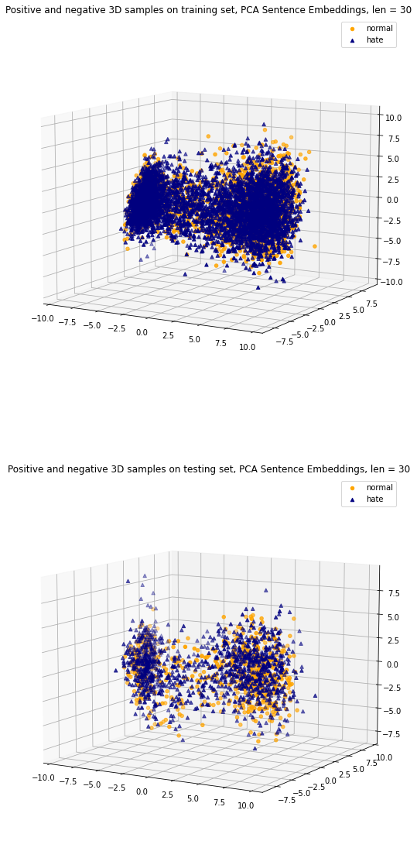
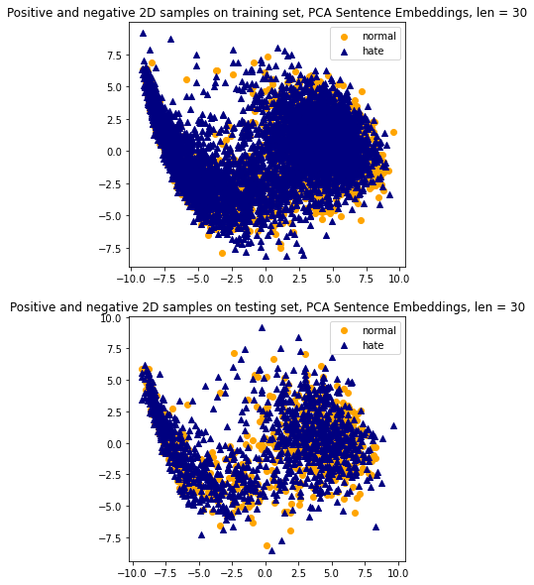
Our Sentence Data Cont.
Concatenate word embeddings, then applying PCA to it as the embedding of whole sentence
Applying PCA on sentence embeddings of training and testing set
Different class of sentences are clustering together

Slide 24
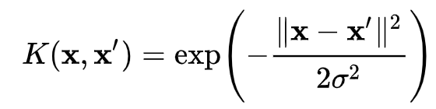
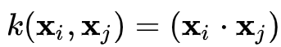
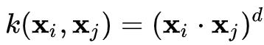
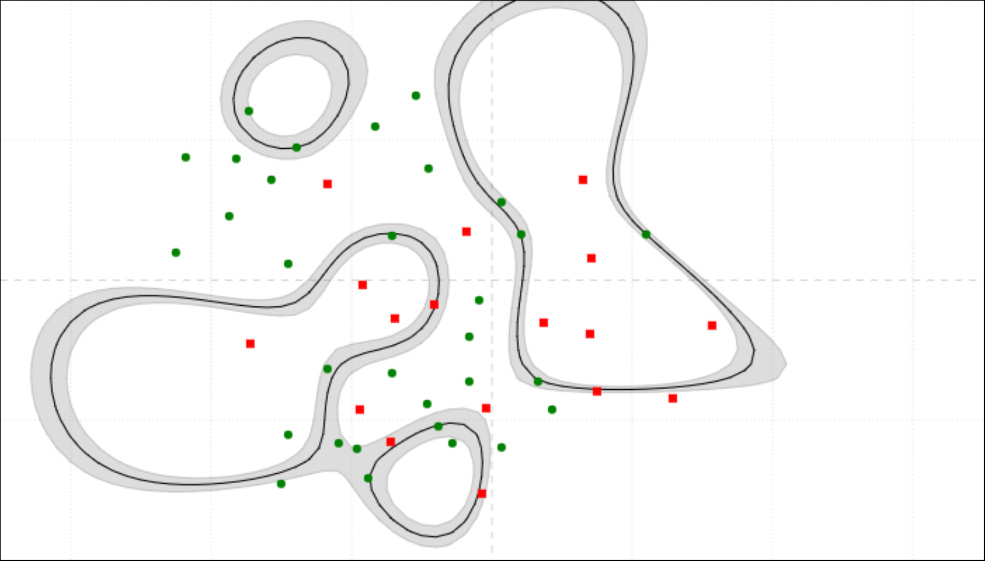
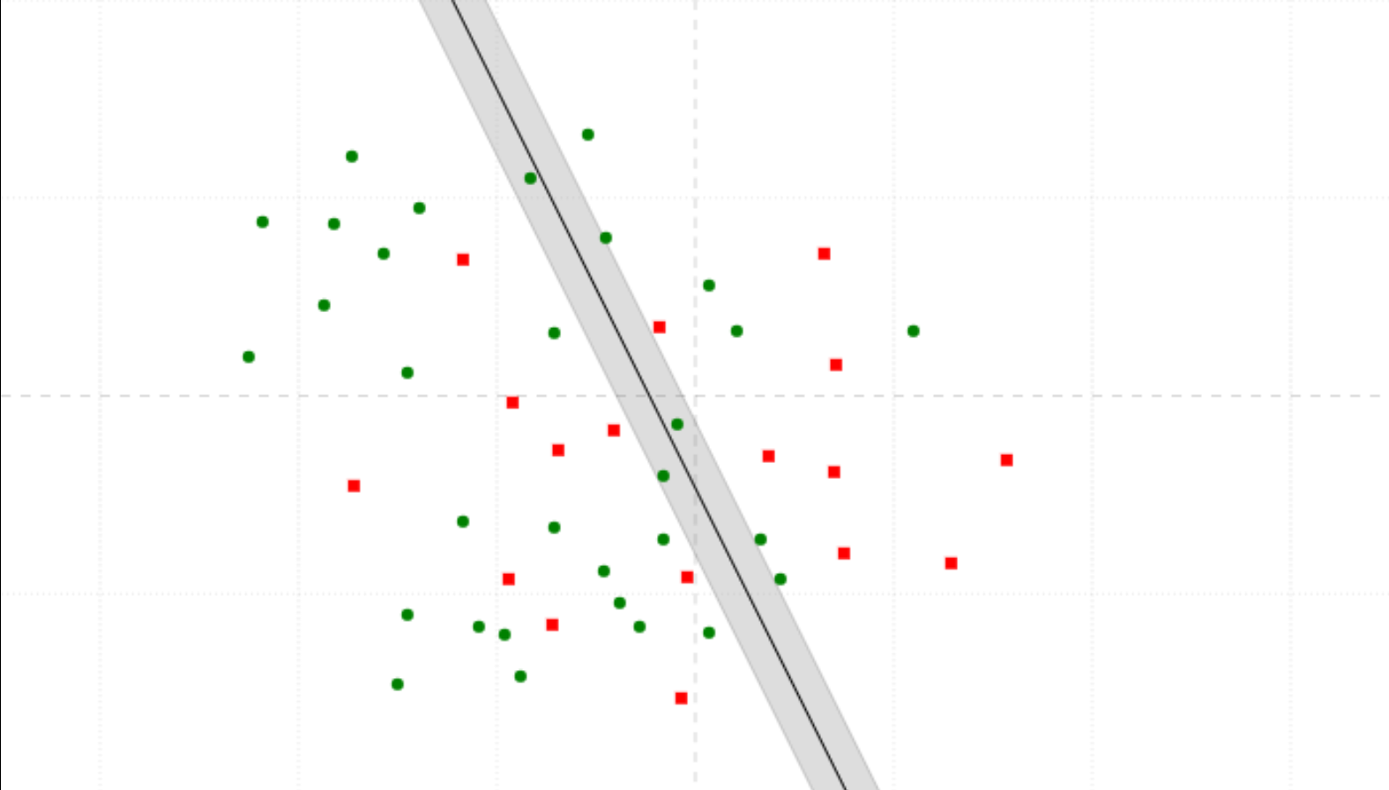
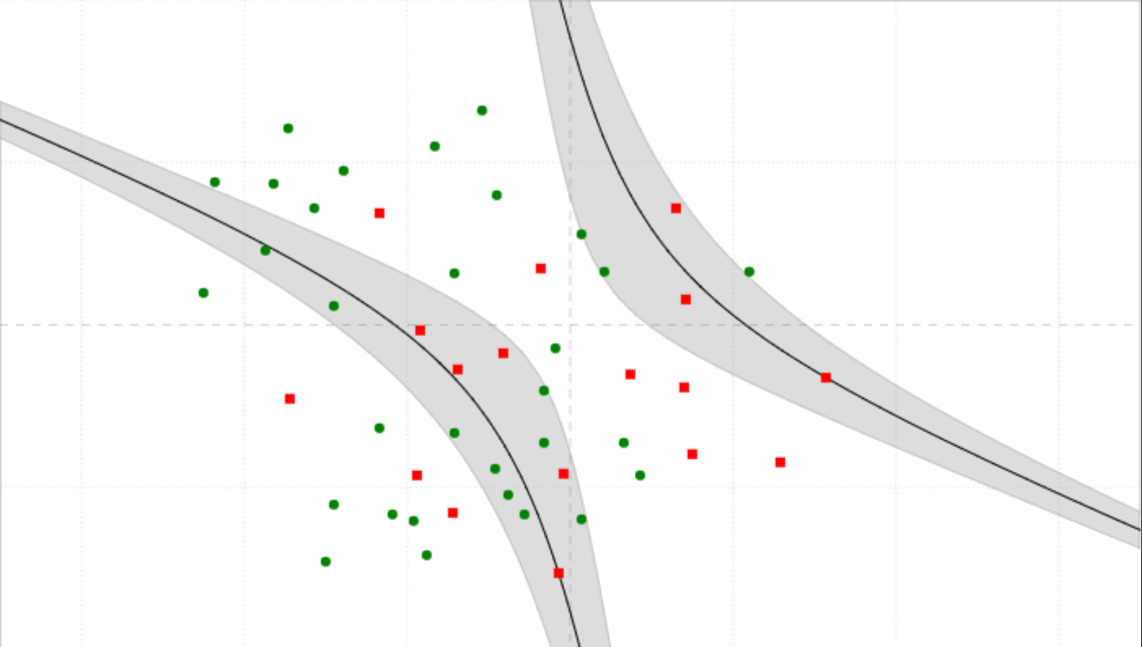
RBF (Radial Basis Function) Kernel
Superiority in handling non-linear, clustering data points

Slide 25
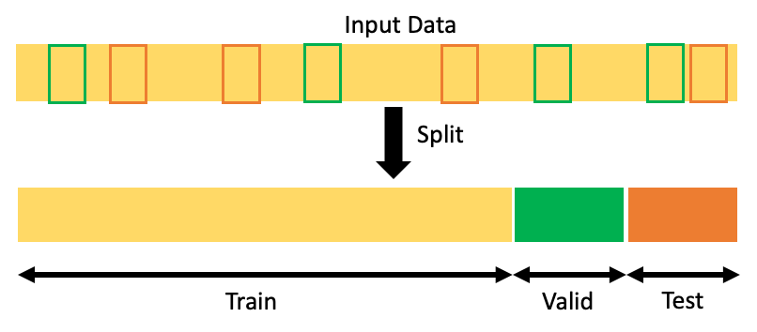
Dataset Splitting
 | train | validation | test
normal | 4212 | 470 | 1158
hate | 2245 | 248 | 636
total | 6457 | 718 | 1794
70%
10%
20%

Slide 26
Sentence Embedding
Phase I. SUM
“社会”
[ 0.80167, -0.19782, -2.1480 , …… ]
100 dim.
SUM
...
100 dim.
“国家”
[ 0.89913 , 0.03451, 0.26539, …… ]

Slide 27
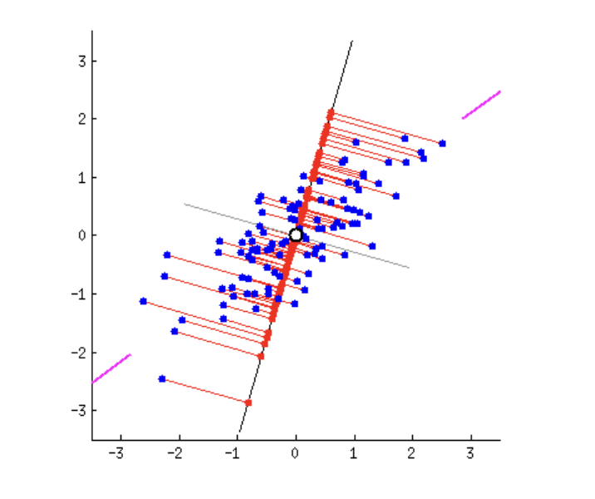
Sentence Embedding Cont.
Phase II. PCA
“社会”
...
“国家”
[ 0.80167, -0.19782, -2.1480 , …… ]
[ 0.89913 , 0.03451, 0.26539, …… ]
100 dim.
100 dim.
Principle Components Analysis
100 * N dim.
N_comp dim.

Slide 28
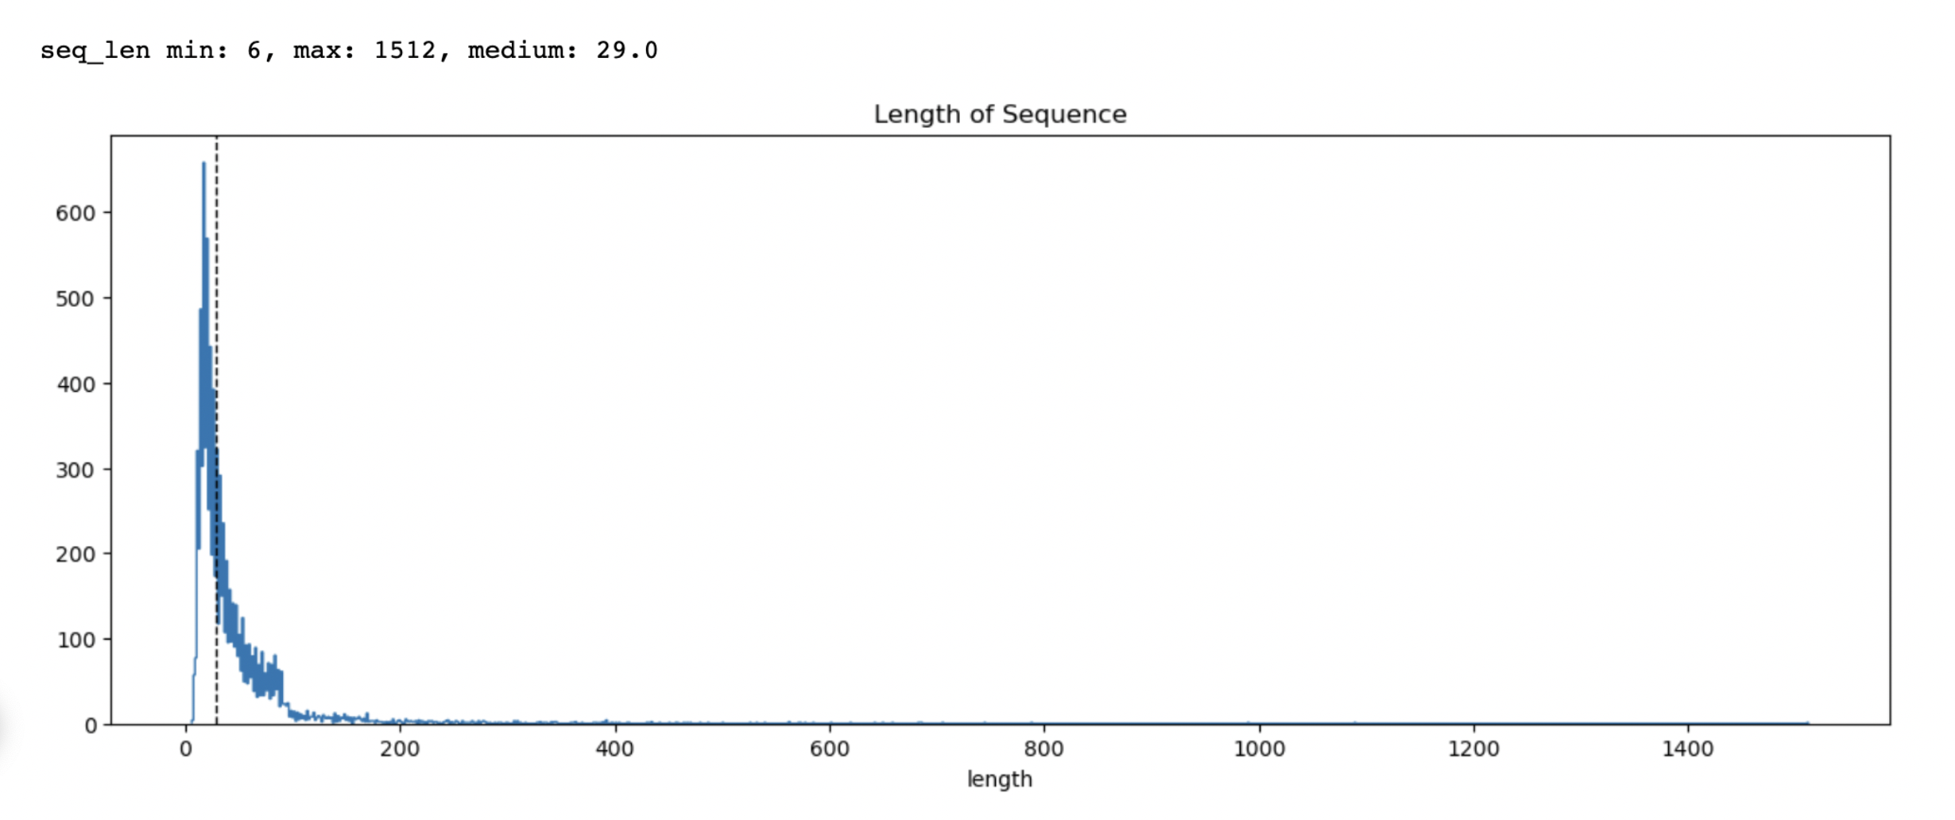
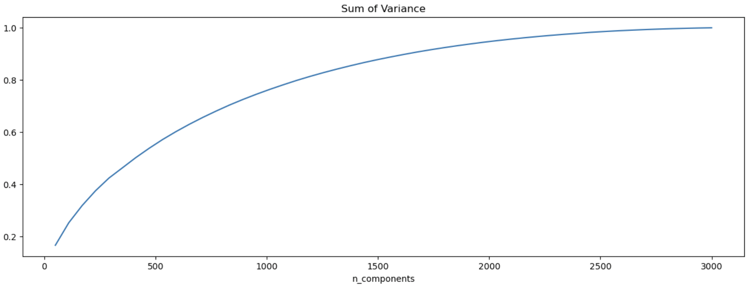
Sentence Embedding Cont.
How long should we keep a sentence?
How much information do we need?

Slide 29
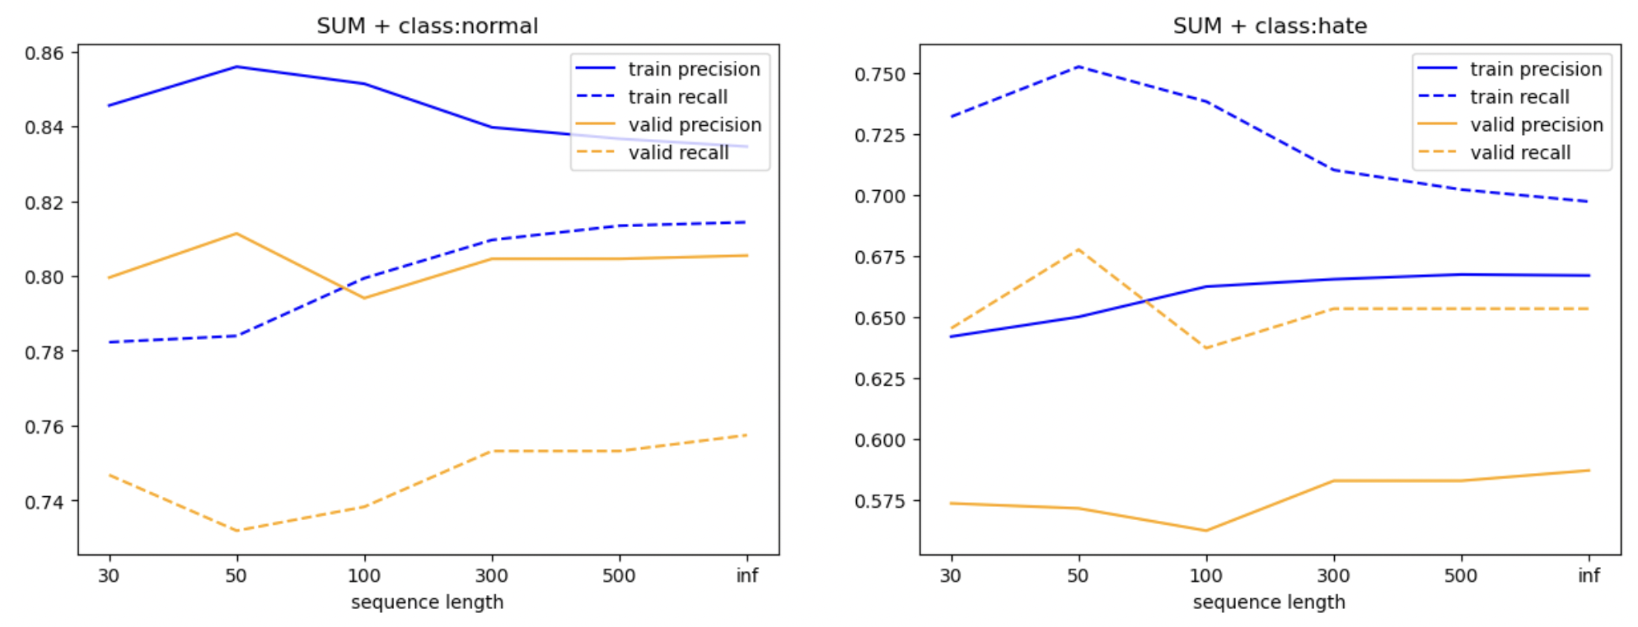
Hyper-Parameter Tuning

Slide 30
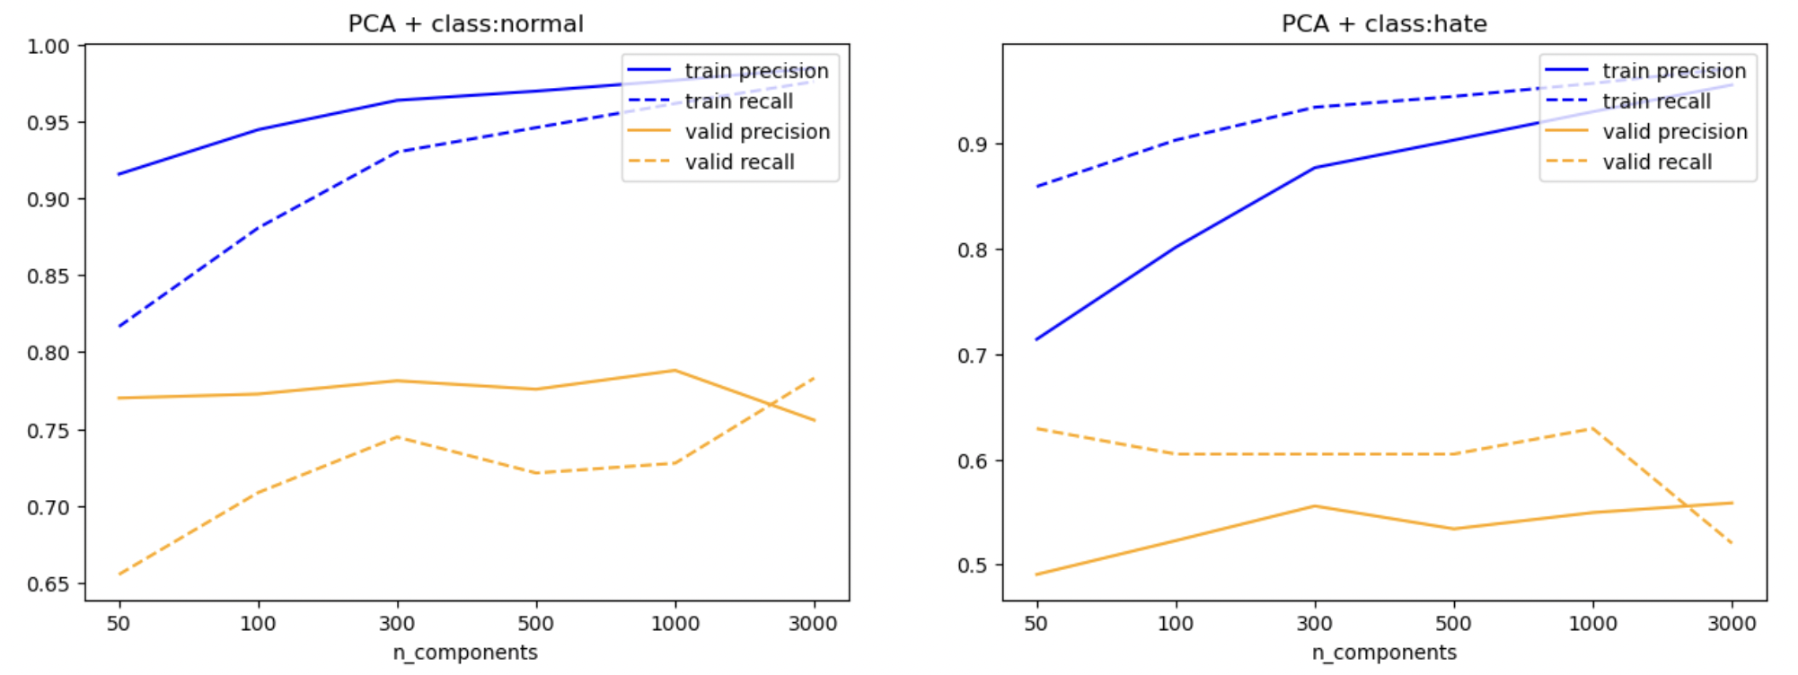
Hyper-Parameter Tuning Cont.

Slide 31
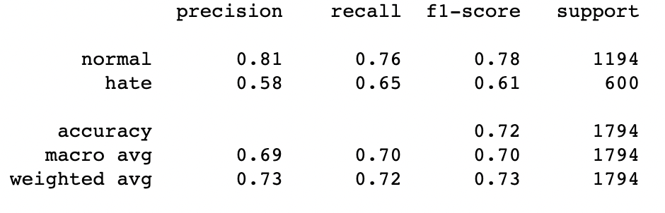
Classification Result
Word2vec(100) + Sequence Length(30) + PCA(500)

Slide 32
Q & A
Thanks for watching!

